Slide 1

Velammal Engineering College
(An Autonomous Institution, Affiliated to Anna University, Chennai)
(Accredited by NAAC & NBA)
INTRODUCTION TO GRAPH
Dr.M.Usha
Assistant Professor,
Department of CSE
Velammal engineering College

Slide 2
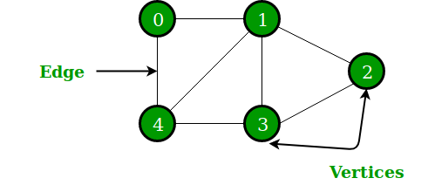
GRAPH
A Graph is a non-linear data structure consisting of nodes and edges.
The nodes are sometimes also referred to as vertices and the edges are lines or arcs that connect any two nodes in the graph.
Generally, a graph G is represented as G=(V,E) where V is set of vertices and E is set of edges.
In this above Graph, the set of vertices V = {0,1,2,3,4} and the set of edges E = {01, 12, 23, 34, 04, 14, 13}.

Slide 3
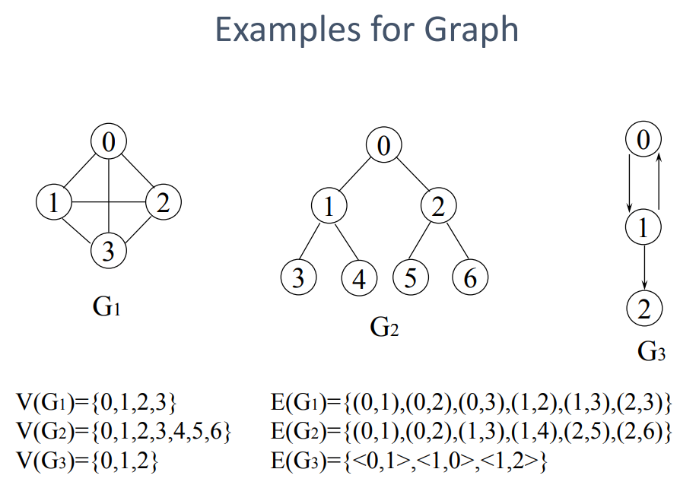

Slide 4
APPLICATIONS
Graphs are used to solve many real-life problems.
Graphs are used to represent networks.
The networks may include paths in a city or telephone network or circuit network.
Graphs are also used in social networks like linkedIn, Facebook.
For example, in Facebook, each person is represented with a vertex(or node).
Each node is a structure and contains information like person id, name, gender, locale etc.

Slide 5
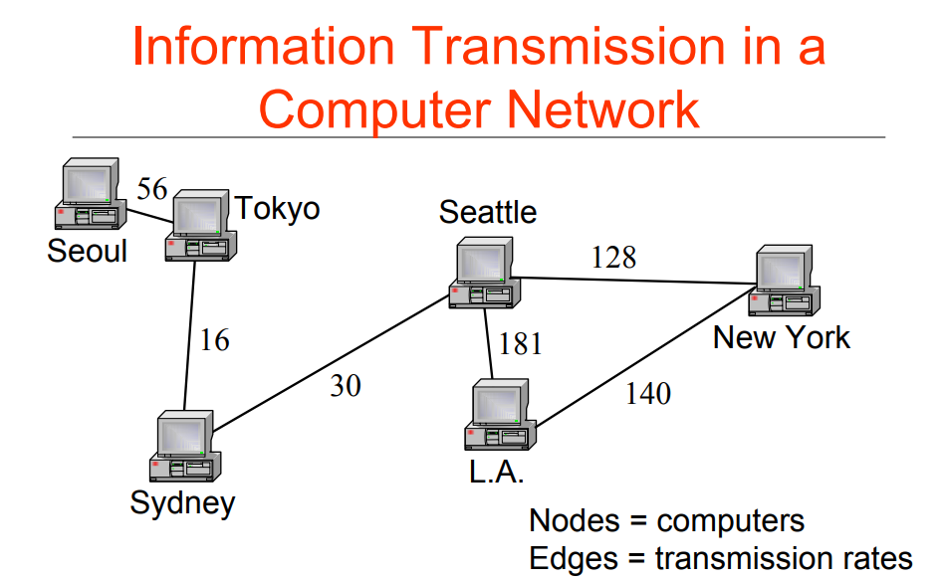

Slide 7
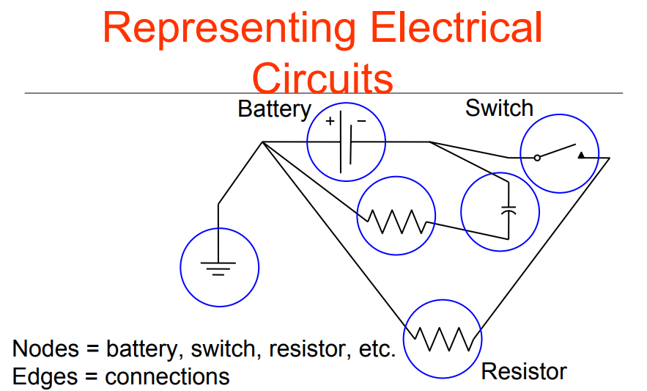

Slide 8
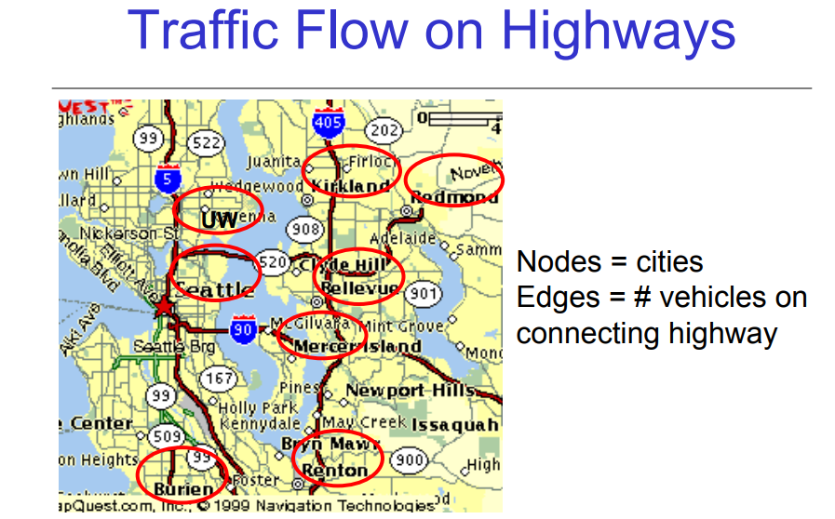

Slide 9
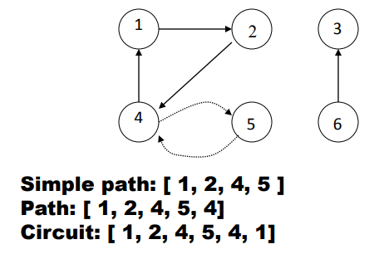
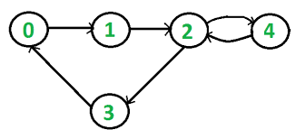
GRAPH TERMINOLOGIES
A path is a sequence of vertices such that there is an edge from each vertex to its successor.
A path is simple if each vertex is distinct/A path with no repeated vertices is called a simple path.
A circuit is a path in which the terminal vertex coincides with the initial vertex.(Vertices may repeat but edges are not allowed to repeat.)
Cycle: A circuit that doesn't repeat vertices is called a cycle.(Neither vertices (except possibly the starting and ending vertices) are allowed to repeat, Nor edges are allowed to repeat.
0-1-2-3-0 - CYCLE 0-1-2-4-2-3-0(CIRCUIT)

Slide 10
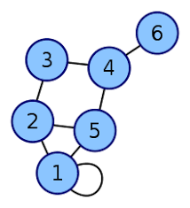
Self loop: If there is an edge whose starting and end vertices are same, that is, (vi, vj) is an edge, then it is called a self loop.
Adjacent Vertices Two vertices are said to be adjacent if there is an edge (arc) connecting them.
Adjacent Edges Adjacent edges are edges that share a common vertex.

Slide 11
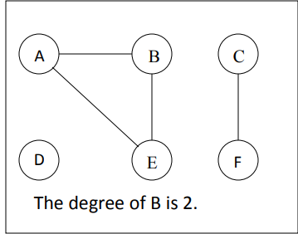
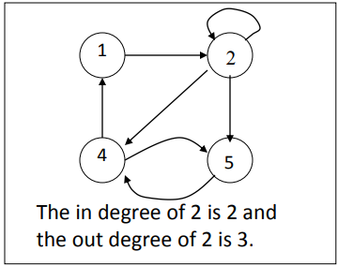
Degree of the Node
A degree of a node is the number of edges that are connected with that node. A node with degree 0 is called as isolated node.
In degree: Number of edges entering a node
• Out degree: Number of edges leaving a node
• Degree = Indegree + Outdegree

Slide 12
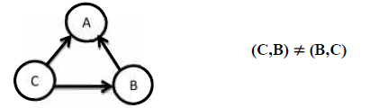
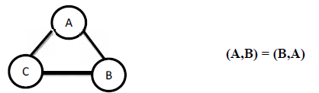
TYPES OF GRAPH
Directed Graph (or) Digraph
Directed graph is a graph which consists of directed edges, where each edge in E is unidirectional.
It is also referred as Digraph. If (v,w) is a directed edge then (v,w) # (w,v)
Undirected Graph
An undirected graph is a graph, which consists of undirected edges. If (v,w) is an undirected edge, then (v,w)=(w,v)

Slide 13
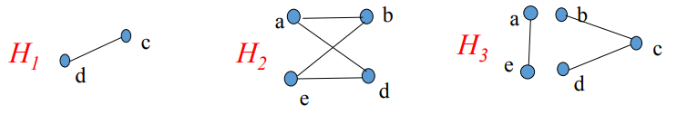
Connected and Disconnected
A graph G is said to be connected if there exists a path between every pair of vertices.
A connected graph is the one in which some path exists between every two vertices (u, v) in V.
There are no isolated nodes in connected graph.
UNCONNECTED/DisConnected GRAPH: A graph is said as unconnected graph if there exist any 2 unconnected components.
Example: • H1 and H2 are connected • H3 is disconnected

Slide 14
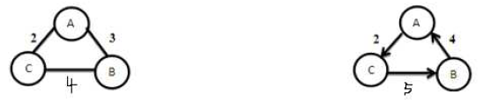
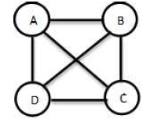
CONT..
Weighted Graph
A graph is said to be weighted graph if every edge in the graph is assigned a weight or value. It can be directed or undirected graph.
Complete Graph
A complete graph is a graph in which there is an direct edge between every pair of vertices.
A complete graph with n vertices will have n(n-1)/2 edges.
There is a path from every vertex to every other vertex.
All complete graphs are connected graphs, but not all connected graphs are complete graphs.
A complete digraph is a strongly connected graph.

Slide 15
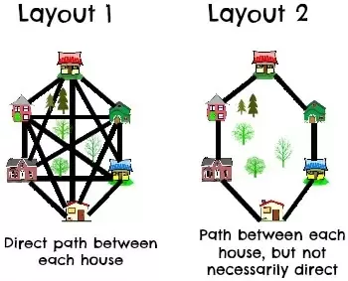

Slide 16
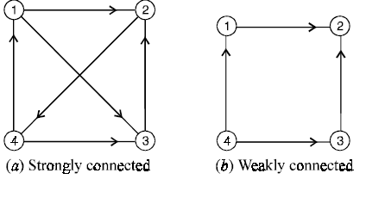
CONT..
Strongly Connected Graph
If there is a path from every vertex to every other vertex in a directed graph then it is said to be strongly connected graph.
Weakly Connected Graph:
If there does not exist a path from one vertex to another vertex then it is said to be a weakly connected graph.

Slide 17
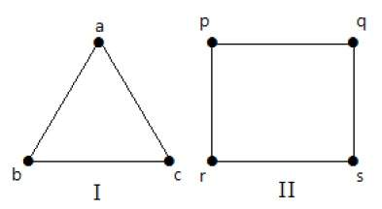
Regular Graph
A graph G is said to be regular, if all its vertices have the same degree. In a graph, if the degree of each vertex is ‘k’, then the graph is called a ‘k-regular graph’.
In the following graphs, all the vertices have the same degree. So these graphs are called regular graphs.
In both the graphs, all the vertices have degree 2. They are called 2-Regular Graphs.

Slide 18
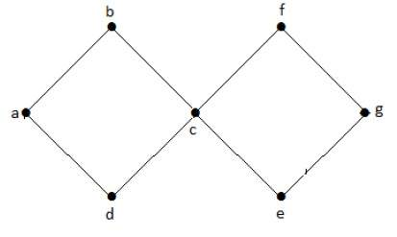
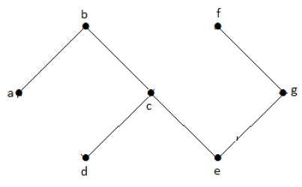
CYCLIC AND ACYCLIC GRPH
Cyclic Graph
A graph with at least one cycle is called a cyclic graph.
Example
In the above example graph, we have two cycles a-b-c-d-a and c-f-g-e-c. Hence it is called a cyclic graph
Acyclic Graph
A graph with no cycles is called an acyclic graph.

Slide 19
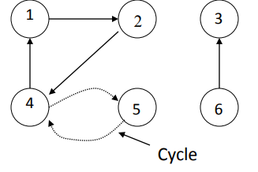
CYCLIC AND ACYCLIC GRPH
Acyclic Graph
A directional graph which has no cycles is referred to as acyclic graph. It is abbreviated as DAG (Directioinal Acyclic Graph).
If there is a path containing one or more edges which starts from a vertex vi and terminates into the same vertex then the path is known as a cycle.
If a graph(digraph) does not have any cycle then it is called acyclic graph.

Slide 20
GRAPH REPRESENTATION
Graph data structure is represented using following representations...
Adjacency Matrix
Incidence Matrix
Adjacency List

Slide 21
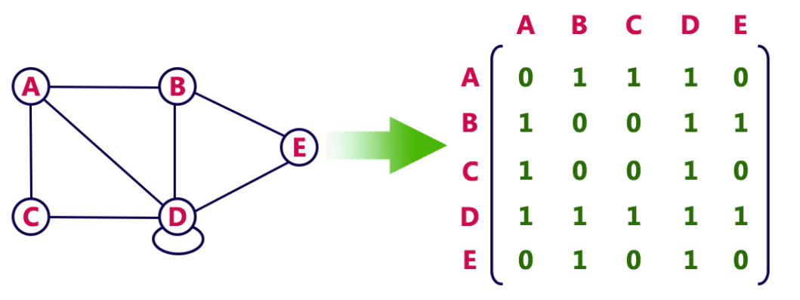
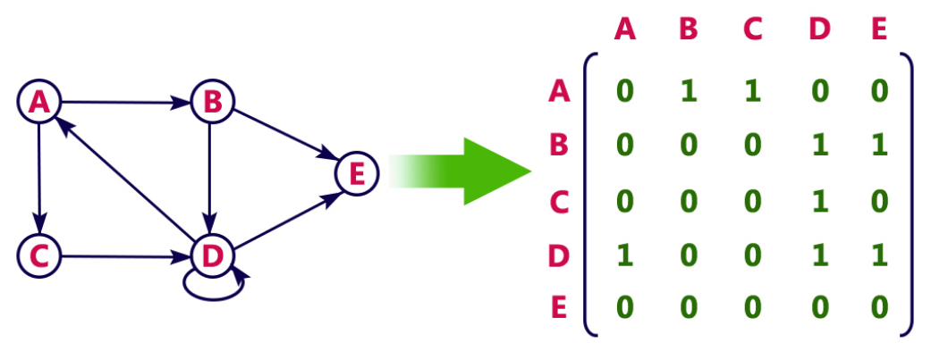
ADJACENCY MATRIX
The adjacency matrix A for a graph G = (V,E) with n vertices, is an n* n matrix of bits ,
such that A ij = 1 , if there is an edge from vi to vj and
Aij = 0, if there is no such edge

Slide 22
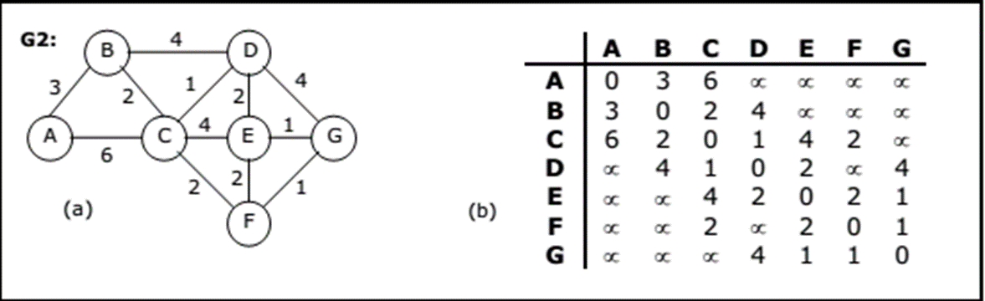

Slide 23
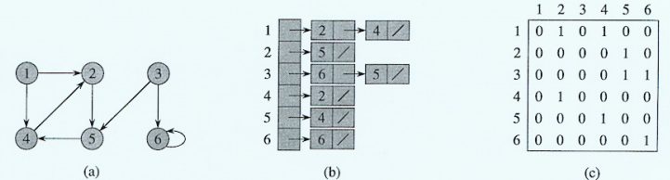
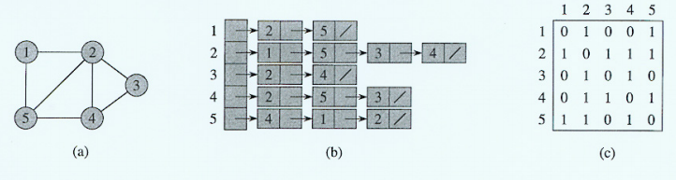
ADJACENCY LIST
A graph containing m vertices and n edges can be represented using a linked list, referred
to as adjacency list.
The number of vertices in a graph forms a singly linked list.
Each vertex have a separate linked list, with nodes equal to the number of edges connected from the corresponding vertex..
Each nodes has at least 2 fields: VERTEX and LINK.
The VERTEX fields contain the indices of the vertices adjacent to vertex i.

Slide 24
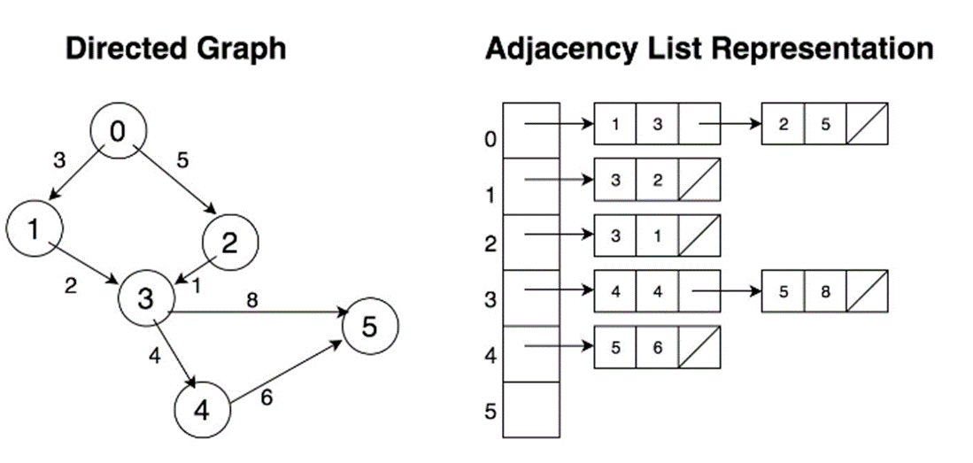

Slide 25
Incidence Matrix
A graph containing m vertices and n edges can be represented by a matrix with m rows and n columns.
The matrix formed by storing 1 in the ith row and jth column corresponding to the matrix, if there exists a ith vertex, connected to one end of the jth edge, and 0, if there is no ith vertex, connected to any end of the jth edge of the graph, such a matrix is referred as an incidence matrix.
IncMat [i] [j] = 1,if there is an edge Ejfrom vertex Vi
= 0, otherwise

Slide 26
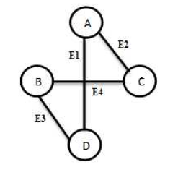
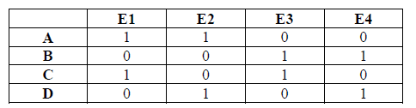
EXAMPLE

Slide 27
Graph Traversals
A graph traversal is a systematic way of visiting the nodes in a specific order.
There are 2 types of graph traversals namely,
➢ Breadth First Search(BFS)
➢ Depth First Search(DFS)

Slide 28
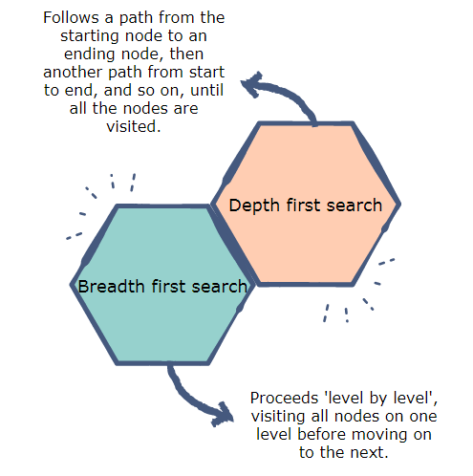

Slide 29
Depth first search
Visit the first node initially, and then find the unvisited node which is adjacent to the first node, is visited and a DFS is initiated from the adjacent node (considering it as the first node).
If all the adjacent nodes have been visited, backtrack to the last node visited, and find another adjacent node and again initiate the DFS from adjacent node.
This traversal continues until all nodes have been visited once.

Slide 30
Steps to Implement DFS
1. Select the start vertex
2. Visit the vertex ( place 1)
3. Push the vertex on the stack
4. pop the vertex
5. find the adjacent vertices and find any one of the unvisited adjacent vertex
6. repeat from step 2 to 5 until the stack becomes empty

Slide 31
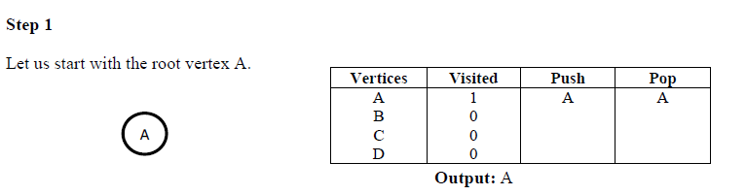
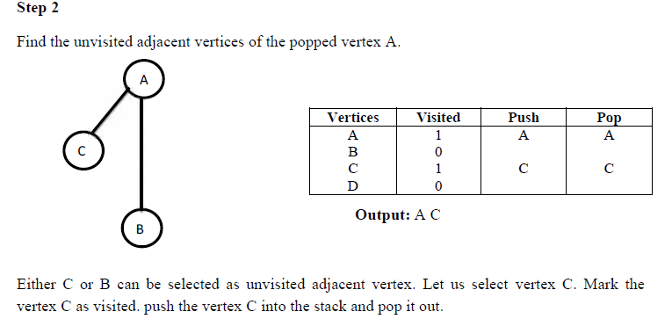
Mark the vertex A as visited. push the vertex A into the stack and pop it out.

Slide 32
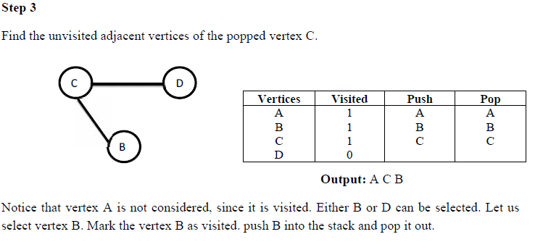
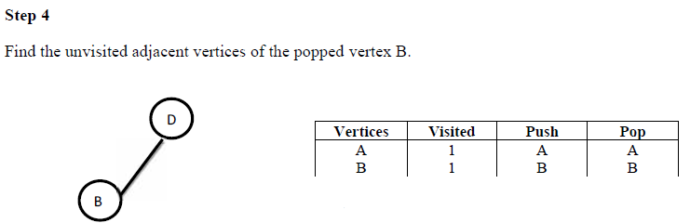
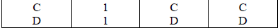

Slide 33
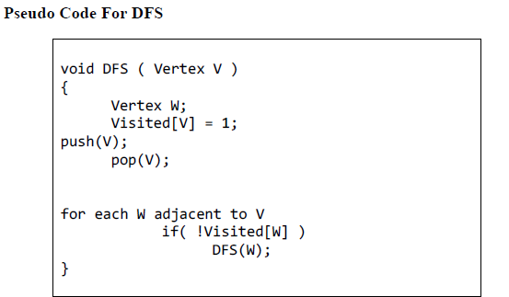
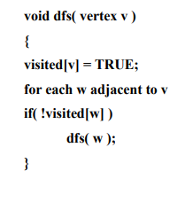
Step 5
Since all the vertices of D are visited, and all the vertices in the graph are visited, DFS ends.
The output is the order in which the vertices are popped out. Output: A C B D.

Slide 34
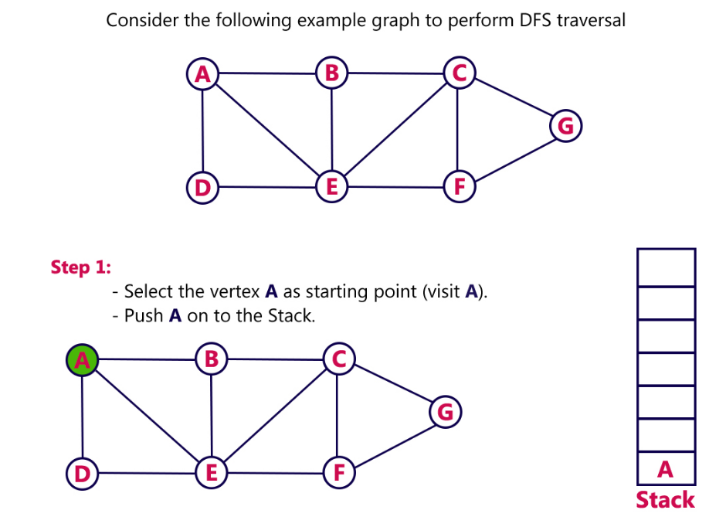
EXAMPLE 2:

Slide 35
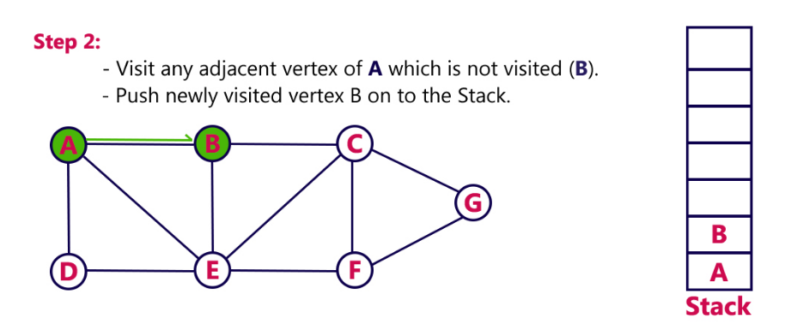
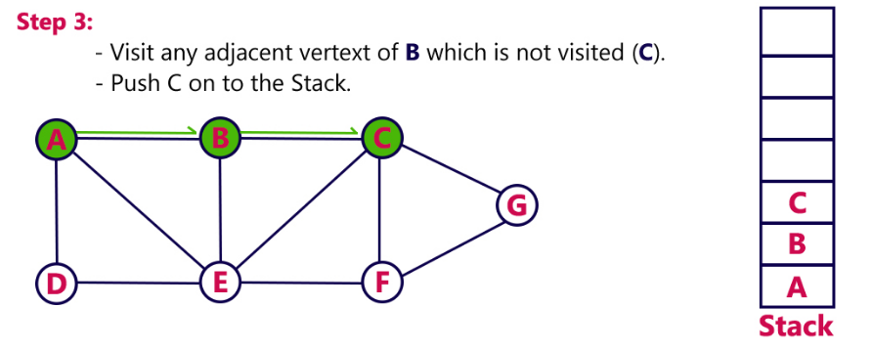

Slide 36
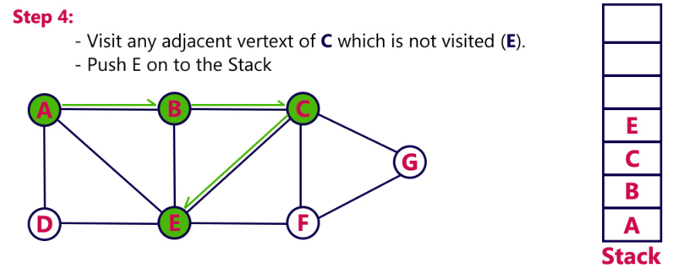
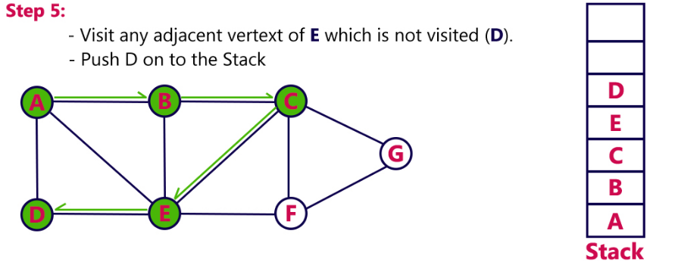

Slide 37
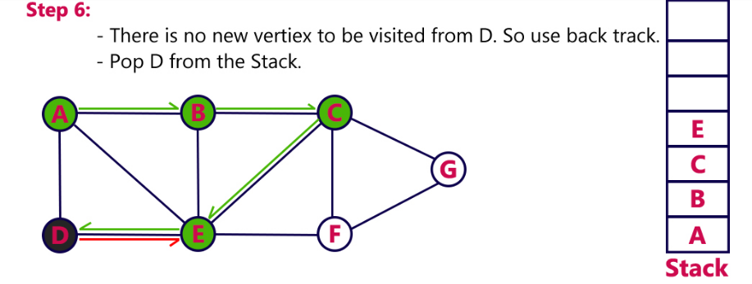
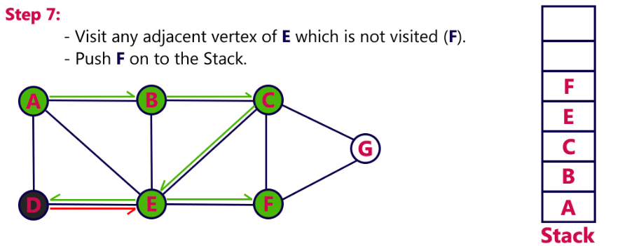

Slide 38
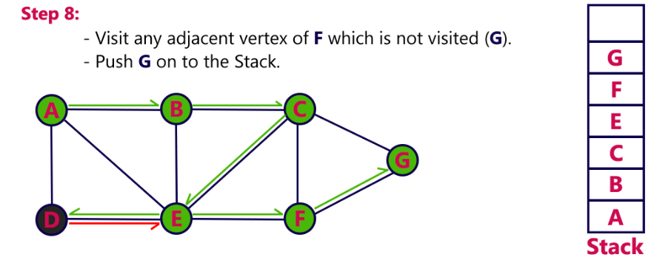
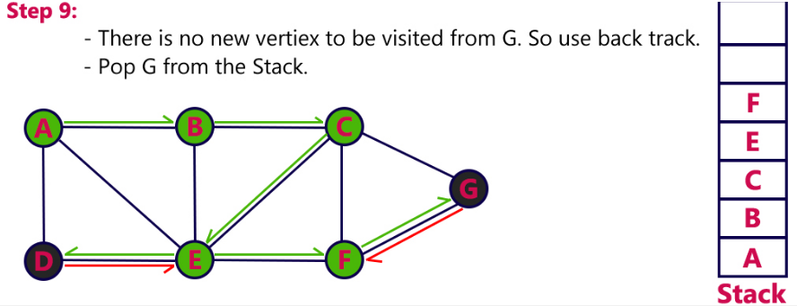

Slide 39
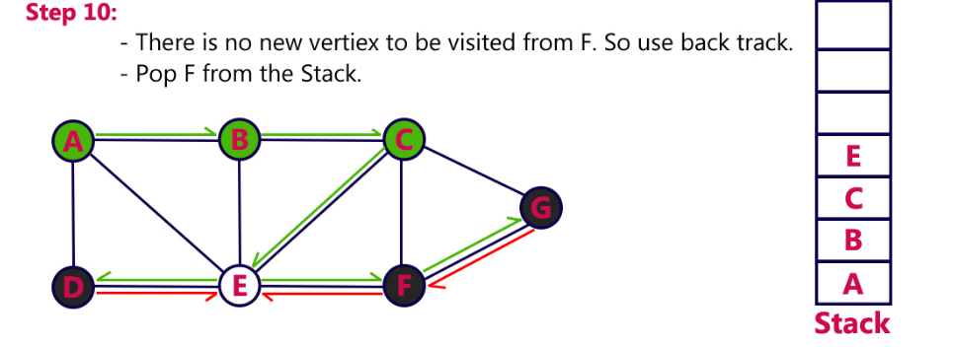
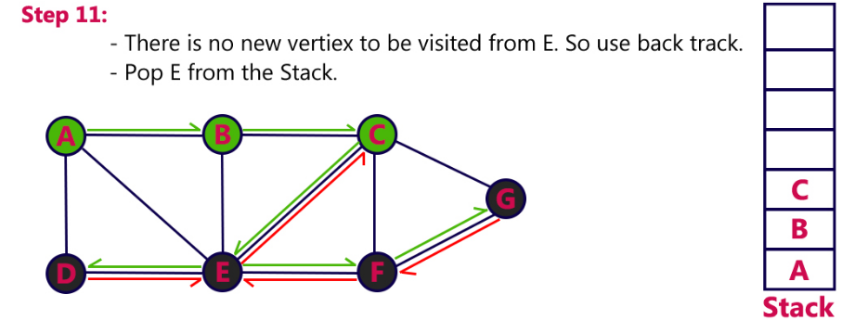

Slide 40
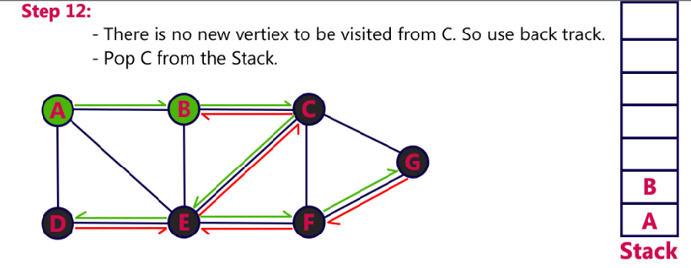
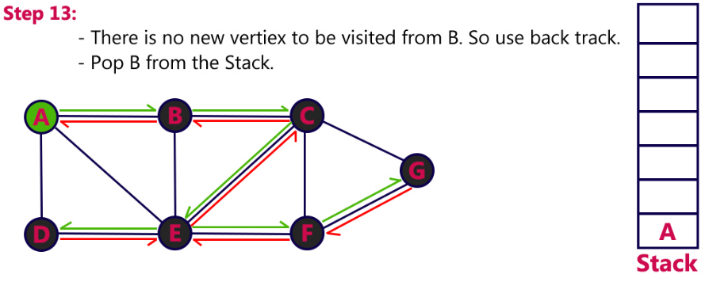

Slide 41

A-B-C-E-D-F-G

Slide 42
Applications of DFS
➢ To check whether the undirected graph is connected or not
➢ To check if the connected undirected graph is bi-connected or not
➢ To check whether the directed graph is a-cyclic or not

Slide 43
BFS (Breadth First Search)
Breadth First Search (BFS) of a graph G starts from an unvisited vertex u.
Then all unvisited vertices vi adjacent to u are visited and then all unvisited vertices wj adjacent to vi are visited and so on.
The traversal terminates when there are no more nodes to visit.
BFS uses a queue data structure to keep track of the order of the nodes whose adjacent nodes are to be visited.

Slide 44
Steps to Implement BFS
1. Select the start vertex and mark it as visited (i.e) place the value 1
2. Enqueue the START vertex.
3. Dequeue the vertex.
4. Find all adjacent unvisited vertices of the dequeued vertex.
5. Mark all unvisited adjacent vertices as visited.
6. Enqueue all adjacent vertices.
7. Repeat from step 3 to step 6 until the queue becomes empty

Slide 45



Slide 46



Slide 47


Slide 48

Pseudo Code For BFS

Slide 49
Applications of BFS
1. To find the shortest path from a vertex s to a vertex v in an unweighted graph
2. To find the length of such a path
3. To find out if a graph contains cycles
4. To construct a BFS tree/forest from a graph

Slide 50

EXAMPLE 2
Front, rear

Slide 51



Slide 52



Slide 53



Slide 54


A-D-B-E-C-F-G

Slide 55
Comparison between DFS and BFS
DFS | BFS
DFS visit nodes of graph depth wise. It visits nodes until reach a leaf or a node which doesn’t have non-visited nodes. | BFS visit nodes level by level in Graph.
Usually implemented using a stack data structure. | Usually implemented using a queue data structure.
Generally requires less memory than BFS. | Generally requires more memory than DFS.
Not Optimal for finding the shortest distance. | optimal for finding the shortest distance.
DFS is better when target is far from source. | BFS is better when target is closer to source.

Slide 56
CONT..
DFS | BFS
DFS is more suitable for game or puzzle problems. We make a decision, then explore all paths through this decision. And if this decision leads to win situation, we stop. | BFS considers all neighbors first and therefore not suitable for decision making trees used in games or puzzles.
Time Complexity of BFS = O(V+E) where V is vertices and E is edges. | Time Complexity of DFS is also O(V+E) where V is vertices and E is edges.
Some Applications: Finding all connected components in a graph. Finding the shortest path between two nodes. Finding all nodes within one connected component. Testing a graph for bipartiteness. | Some Applications: Topological Sorting. Finding connected components. Solving puzzles such as maze. Finding strongly connected components. Finding articulation points (cut vertices) of the graph.

Slide 57
TOPOLOGICAL SORTING
It is a linear ordering of vertices in a directed a-cyclic graph, such that if there is a path from Vi to Vj, then Vj appears after Vi in the linear ordering.
Topological sort is not possible if the graph has a cycle.
Procedure
1. Find the indegree for every vertex
2. Place the vertices whose indegree is zero on the empty queue
3. Dequeue one vertex at a time from the queue and decrement the indegree of all its adjacent vertices
4. Enqueue a vertex to the queue if its indegree falls to zero
5. Repeat from step step 3 unitl the queue becomes empty
The topological ordering is the order in which the vertices are dequeued.

Slide 58


EXAMPLE
Find the number of different topological orderings possible for the given graph.

Slide 59



Step-02:
Vertex-1 has the least in-degree.
So, remove vertex-1 and its associated edges.
Now, update the in-degree of other vertices.
Step-03:
There are two vertices with the least in-degree. So, following 2 cases are possible-
In case-01,
Remove vertex-2 and its associated edges.
Then, update the in-degree of other vertices.
In case-02,
Remove vertex-3 and its associated edges.
Then, update the in-degree of other vertices.

Slide 60

Step-04:
Now, the above two cases are continued separately in the similar manner.
In case-01,
Remove vertex-3 since it has the least in-degree.
Then, update the in-degree of other vertices.
In case-02,
Remove vertex-2 since it has the least in-degree.
Then, update the in-degree of other vertices.

Slide 61

Step-05:
In case-01,
Remove vertex-4 since it has the least in-degree.
Then, update the in-degree of other vertices.
In case-02,
Remove vertex-4 since it has the least in-degree.
Then, update the in-degree of other vertices.

Slide 62

Step-06:
In case-01,There are 2 vertices with the least in-degree.
So, 2 cases are possible.
Any of the two vertices may be taken first.
Same is with case-02.

Slide 63
Applications of Topological Sort
Few important applications of topological sort are-
Scheduling jobs from the given dependencies among jobs
Instruction Scheduling
Determining the order of compilation tasks to perform in makefiles
Data Serialization

Slide 64


Pseudo Code For Topological Sort

Slide 65



EXAMPLE
Step 1
Find the Indegree of vertices 1,2,3,4,5,6.
Indegree of a vertex is the number of edges entering into the vertex. Indegree of vertex 1 is 0, vertex 2 is 0, vertex 3 is 1, vertex 4 is 3, vertex 5 is 1, vertex 6 is 3.
Step 2
enqueue() the vertices with Indegree 0. Therefore enqueue() vertices 1 and 2.

Slide 66


Slide 67


Slide 68



Slide 69


Slide 70


Slide 71
Applications:
Topological Sorting is mainly used for scheduling jobs from the given dependencies among jobs.
The jobs are represented by vertices, and there is an edge from x to y if job x must be completed before job y can be started
For example,in constructing a building,the basement must be completed before the first floor,which must be completed before the second floor and so on.
A topological sort gives an order in which we should perform the jobs.
In computer science, applications of this type arise in instruction scheduling, ordering of formula cell evaluation when recomputing formula values in spreadsheets,
Determining the order of compilation tasks to perform in makefiles
Data Serialization

Slide 72
THANK YOU

